Slide 1
ALABEL NATIONAL HIGH SCHOOL

Slide 2
S M E P A
1ST Quarter –QUALITY
TESDA Assessment Result
NAT Comparative Result
PHIL-IRI Comparative Result
Completion Rate

Slide 3
Alabel National High School adopting the “Strengthened Technical Vocational Education Program (STVEP) provides opportunities for students to acquire a National Certificate (NC) and/ or Certificate of Competency (COC) upon graduation. In this regard, the school enters into a partnership with local industries for the students’ exposure and work experience to prepare them for TESDA Assessment.
Trend: Fluctuating
Analysis:
The data shows that the school continually produced graduates with National Certificate (NC I/II) which implies that they are already equipped with lifelong relevant skills upon graduation in high school. On the other hand, the highest percentage of TESDA passers with NC I/II was garnered by the second batch of tech voc graduates with 92.12% in school year 2012-2013.
Facilitating Factor:
Strong school-community partnership
MLGU counterpart Php 600 per student for the assessment fee.
Partnership of the local industries for the students’ exposure and work experience.

Slide 4
NAT Comparative Result in Three Years
Analysis:
The data shows that in two consecutive school years , the overall Mean Percentage Score (MPS) is increasing. Apparently, from the first school year to second, there was a big increase of 8.99% and from the second to third, there was a little increase of .22%.
Facilitating Factors:
Strong school-community partnership for the provision of supplies and materials throughout the preparation of the NAT
Intensive NAT Enhancement Activities
Intensive instructional monitoring and supervision
Barrier:
Students’ absences due to poor economic status, internet addiction, distance from home to school.
Bottleneck:
Overlapping of activities (NAT & TESDA Assessment)
Proposed Solutions:
Strict implementation of municipal ordinance on amusement operation.
MLGU/BLGU shall provide free ride from home to school
TESDA assessment should be done earlier (November-December)

Slide 5
Data Analysis:
Among the five subject areas, Mathematics scored best; scores reached mastery level in three consecutive years.
Araling Panlipunan increased MPS in two consecutive years.
English slightly decreased MPS in two consecutive years, while, Science and Filipino decreased MPS only in the latest result.

Slide 6
PHIL-IRI Comparative Result
SY 2014-2015
Impact: Frustration Readers among Grade 7 students decreased to 3% from 43% .
Facilitating Factors:
1. Creation of 1 section Special Class for Non-Readers in Grade 7.
Teaching in all subjects applied reading approach.
Big Brother/Big Sister (Mentoring) 1 hour per week
Feeding Program sponsored by private individuals
Counseling to students with behavioral problems
2. Computer-Aided Instruction
3. Reading Intervention Activities in all grade 7 classes throughout the year
Drop Everything & Read (DEAR)
Kaklase ko, Sagot Ko (peer mentoring)
4. Home Visitations to students incurred several absences
Bottlenecks:
Not all non-readers are confined in the special class, thus, non-readers belong to regular class are left behind against the many and they tend to leave classes oftentimes resulting to failing marks.
Extreme behavioral problems of students specially children with special needs.
Proposed Solutions:
Additional 1 section of special class for non-readers .
Capacitate teachers teaching children with special needs
 | Independent |  | Instructional |  | Frustration |  | Total # of Students
 | Total | % | Total | % | Total | %
Pre Test | 111 | 16% | 283 | 41% | 297 | 43% | 691
Post Test | 325 | 50% | 306 | 47% | 23 | 3% | 654
% of Inc/Dec |  | 34% |  | 6% |  | -40%

Slide 7
Completion Rate in Three Years
Trend: Increasing
Data Analysis:
1. Completion rate increased in two consecutive years from 96.5% in 2011-2012 to 97.9% in 2013-2014.
2. Between the male and female students, the latter has the higher percentage of completion in three consecutive years.
Facilitating Factors:
1. Conversion of the curriculum from general basic education to Strengthened Technical-Vocational Education Program (STVEP) USING Competency Based Curriculum (CBC)in year 2008.
2. Adopt-A-Student Program by the MLGU,BLGU and private individuals.
3. Catch-up Classes for Retained and Balik-Aral
4. Parenting Seminar
5. Home Visitation for SARDOs
6. Feeding Program
7. Intervention for Reading Deficiency

Slide 8
LORETO J. GINDAP SP-I
Thank You!!!

Slide 9
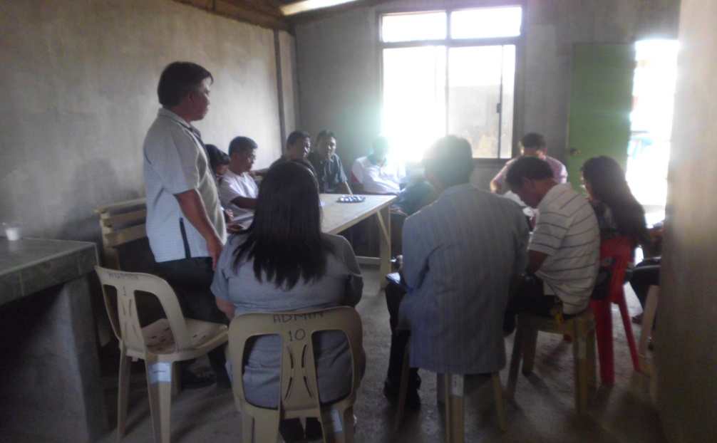
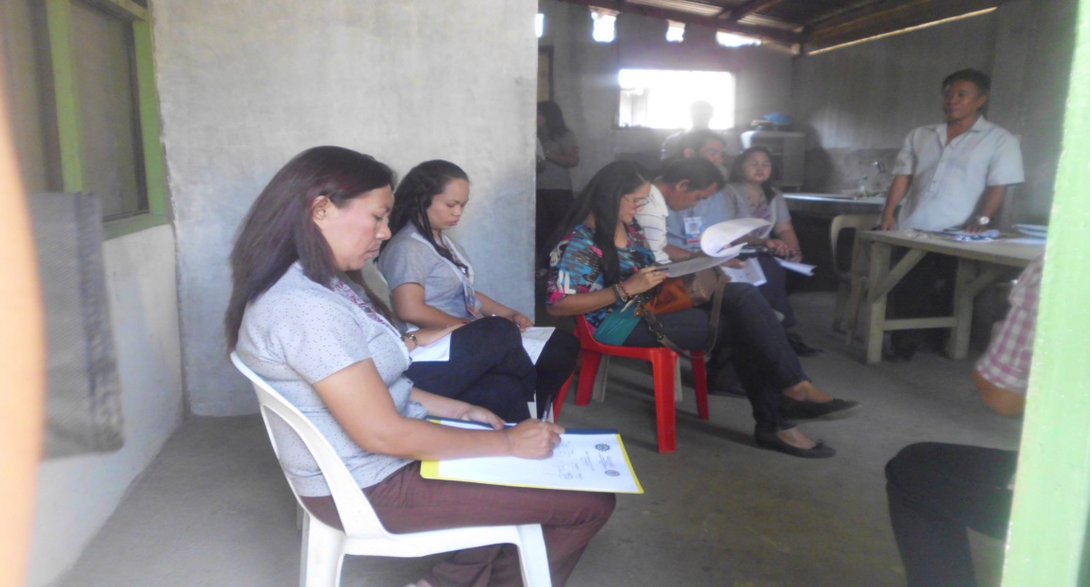
SMEPA 1ST Quarter - Quality
Participants:
School Head
Department Heads
Subject Coordinators
Year Level Chairman
Guidance Counselors
MLGU Representative
BLGU Representative
SGC Officers
PTA Officers

